Slide 1
Struggling and Success in Web Search
Date:2016/02/22
Author:Daan Odijk, Ryen W. White, Ahmed Hassan Awadallah,
Susan T. Dumais
Source:CIKM'15
Advisor:Jia-ling Koh
Spearker:LIN,CI-JIE

Slide 2
Outline
Introduction
Observation
Method
Experiment
Conclusion

Slide 3
Outline
Introduction
Observation
Method
Experiment
Conclusion

Slide 4
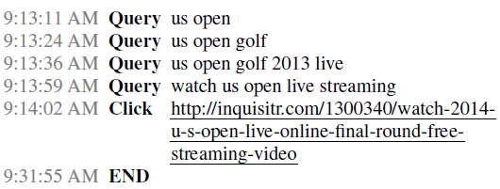
Introduction
Web searchers sometimes struggle to find relevant information
Struggling leads to frustrating and dissatisfying search experiences

Slide 5
Introduction
Better understanding of search tasks where people struggle is important in improving search systems

Slide 6
Introduction
Address this important issue using a mixed methods study using large-scale logs, crowd-sourced labeling, and predictive modeling

Slide 7
Outline
Introduction
Observation
Method
Experiment
Conclusion

Slide 8
Definitions
Sessions
A sequence of search interactions demarcated based on a 30-minute user inactivity timeout

Slide 9
Definitions
Tasks
As topically-coherent sub-sessions, i.e., sequences of search activity within sessions that share a common subject area
Two queries belong to the same task if they are less than ten minutes
(i) share at least one non-stop word term
(ii)share at least one top ten search result or domain name

Slide 10
Definitions
30 min
30 min
30 min
query1 | query2 | query3 | query4 | query5 | query6
session1
session2
session3
session4
task1
task2

Slide 11
DataSet
Microsoft Bing Web search engine
These sessions from the interaction log of Bing for the first seven days of June 2014

Slide 12
Mining Struggling Tasks
Filter sessions
sessions originating from en-US
only considered sessions that started with a typed query
Segment sessions into tasks
refine sessions into topically coherent sub-sessions that cover a single task
Filter struggling tasks
at least three queries where the first two lead to either no clicks or only quick-back clicks

Slide 13
Mining Struggling Tasks
Partition based on final click
Unsuccessful
If a searcher does not click on any result for the final query or when their only clicks are quick-back clicks
Successful
If a searcher clicks on a search results and no interaction for at least 30 seconds

Slide 14
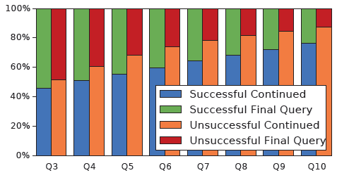
Task Characteristics
Notes:
such as searcher tenacity and sunk cost, that may
explain more of a reluctance to abandon unsuccessful tasks

Slide 15
Interaction Characteristics
Notes:
we observe that queries without clicks are more common in unsuccessful tasks

Slide 16
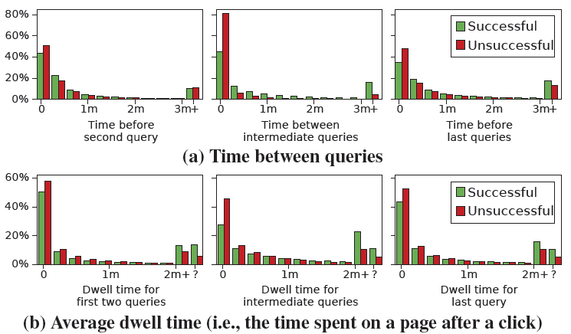
Notes:
Considering the successful tasks, we see the time between queries increases as the task progresses, mostly due to an increase in dwell time

Slide 17
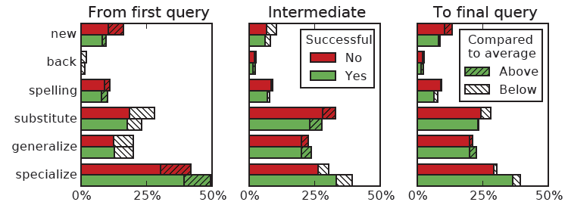
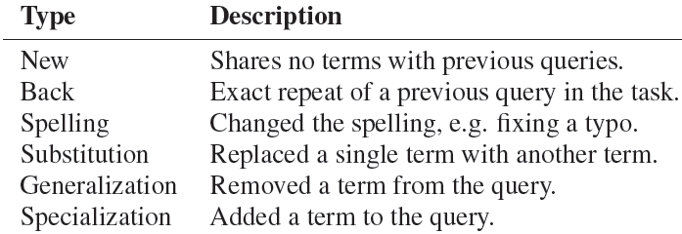
Query Reformulation
Notes:
1.specialization is most likely to occur directly after the first query
2. New queries are most likely as second query and, surprisingly, as the last query

Slide 18
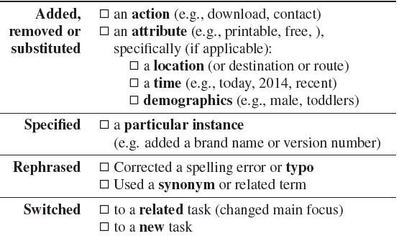
Query transitions
Each task was judged by three human annotators
442 successful tasks
judge how successful they think the searcher was in the task on a four-point scale: not at all, somewhat, mostly, completely

Slide 19
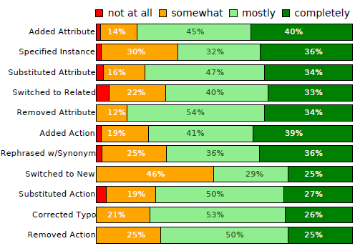
Query transitions
Notes:
It is worth noting that switching to a new task
Specifying an instance also occurs relatively often in the less successful tasks
Addition, substitution, and deletion actions or attributions typically occurs in more successful tasks

Slide 20
Outline
Introduction
Observation
Method
Experiment
Conclusion

Slide 21
Predict reformulation strategy
Predict inter-query transitions during struggling searches
Frame this as a multi-class classification problem; one for each of the 11 query reformulation types
RandomForest classifier

Slide 22
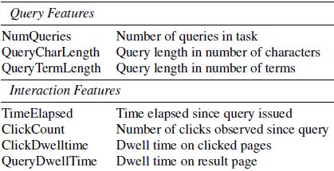
Features

Slide 23
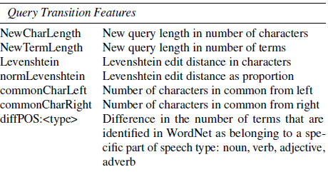
Features

Slide 24
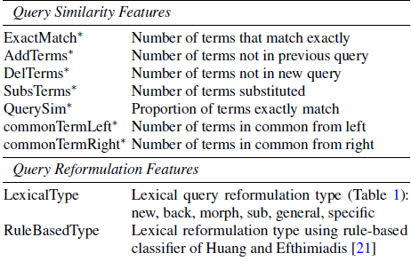
Features

Slide 25
Features
After the first query transition we add history features that represent the reformulation type and previous transition strategy

Slide 26
Outline
Introduction
Observation
Method
Experiment
Conclusion

Slide 27
Experimental Setup
use the 659 labeled tasks with a total of 1802 query transitions

Slide 28
Different stages between two queries
First query
observed the first query and try to predict the next reformulation strategy
First+Interaction
observed the first query and interactions (clicks, dwell time)
Second query
observed both the first and second query

Slide 29
First query
Query Features | Interaction features | Query Transition Features | Query Similarity Features | Query Reformulation Features
classifier
output

Slide 30
First+Interaction
Query Features | Interaction features | Query Transition Features | Query Similarity Features | Query Reformulation Features
classifier
output

Slide 31
Second query
Query Features | Interaction features | Query Transition Features | Query Similarity Features | Query Reformulation Features
classifier
output

Slide 32
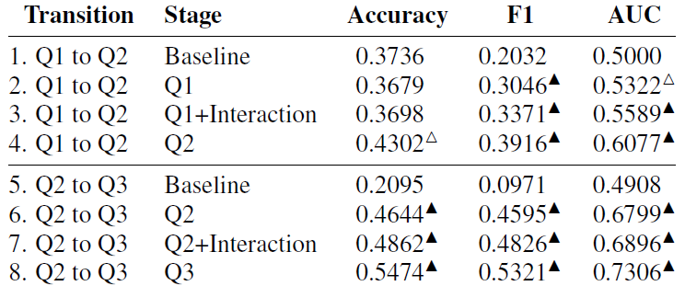

Slide 33
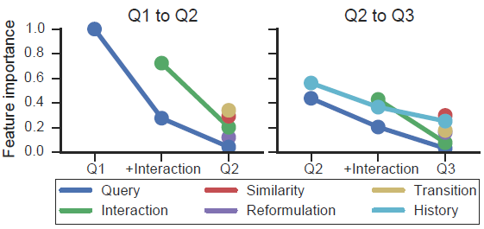

Slide 34
Outline
Introduction
Observation
Method
Experiment
Conclusion

Slide 35
Conclusion
Developed classifiers to accurately predict key aspects of inter-query transitions for struggling searches, with a view to helping searchers struggle less

